Slide 1
Computer-assisted methods for evidence synthesis
William F. Lamb, Max C. Callaghan & Jan C. Minx

Slide 2
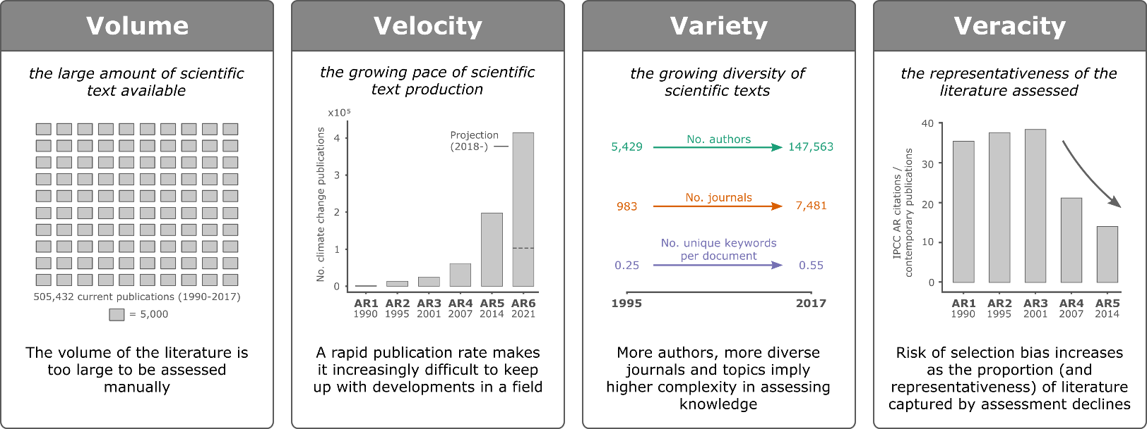
Motivation
Increasing size, rate of change and complexity in publications
Minx, et al. 2018, A data science revolution for global environmental assessments

Slide 3
Motivation
Systematic evidence synthesis methods are time intensive and difficult (Haddaway & Westgate 2018)
the average systematic review takes 157 days
The average systematic map takes 209 days
But they offer good opportunities for automation
Routine tasks that require little cognitive effort: compiling and extracting data
Tasks that are hard for humans: large-scale classification and information discovery
See also:
Westgate M J, Haddaway N R, Cheng S H, McIntosh E J, Marshall C and Lindenmayer D B 2018 Software support for environmental evidence synthesis Nat. Ecol. Evol. 2 588–90

Slide 4
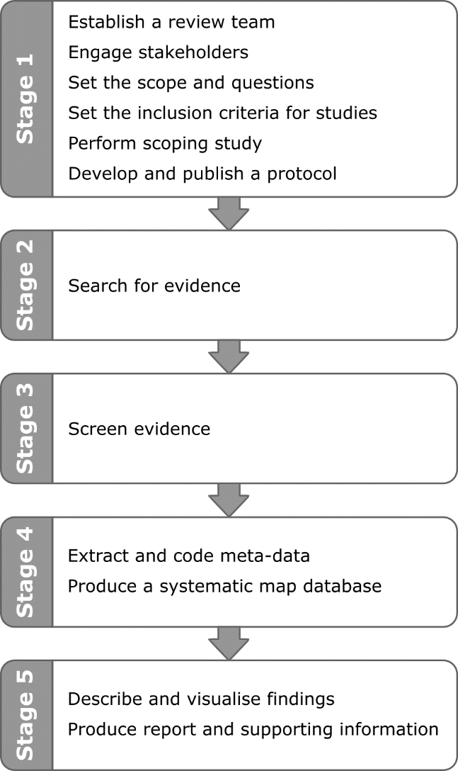
Evidence synthesis stages

Slide 5
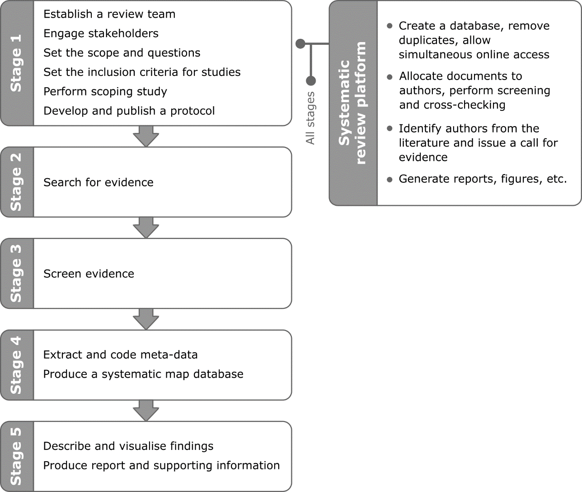
Use an evidence synthesis platform

Slide 6
Use an evidence synthesis platform
Many options: CADIMA, Colandr, Covidence, DistillerSR, EPPI-Reviewer…
Key features to look out for (based on our experience…)
Create and store search queries from multiple databases
Check duplicates
Web-based and multi-user
Document tagging
See also:
Kohl C et al. 2018 Online tools supporting the conduct and reporting of systematic reviews and systematic maps: A case study on CADIMA and review of existing tools Environ. Evid. 7 1–17

Slide 7
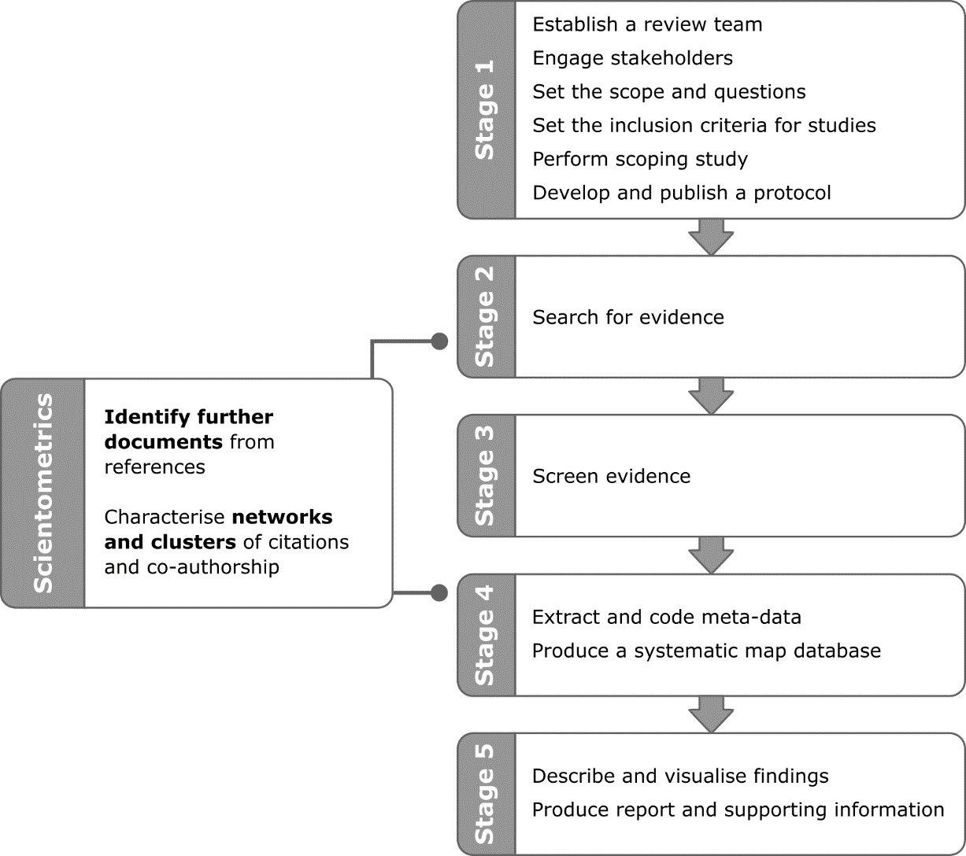
Use scientometrics

Slide 8
Use scientometrics
Which documents are well-referenced by my literature sample, but not included in it? (missing literature)
Which documents in my sample are bibliographically linked via authorship, references or citations? (“core” literatures)
Which documents in my sample are bibliographically isolated? (false positives)
Programs: Sci2, CitNetExplorer, VOSViewer, Gephi
See also:
Cobo M J, López-Herrera A G, Herrera-Viedma E and Herrera F 2011 Science Mapping Software Tools: Review, Analysis, and Cooperative Study Among Tools J. Am. Soc. Inf. Sci. Technol. 62 1382–402

Slide 9
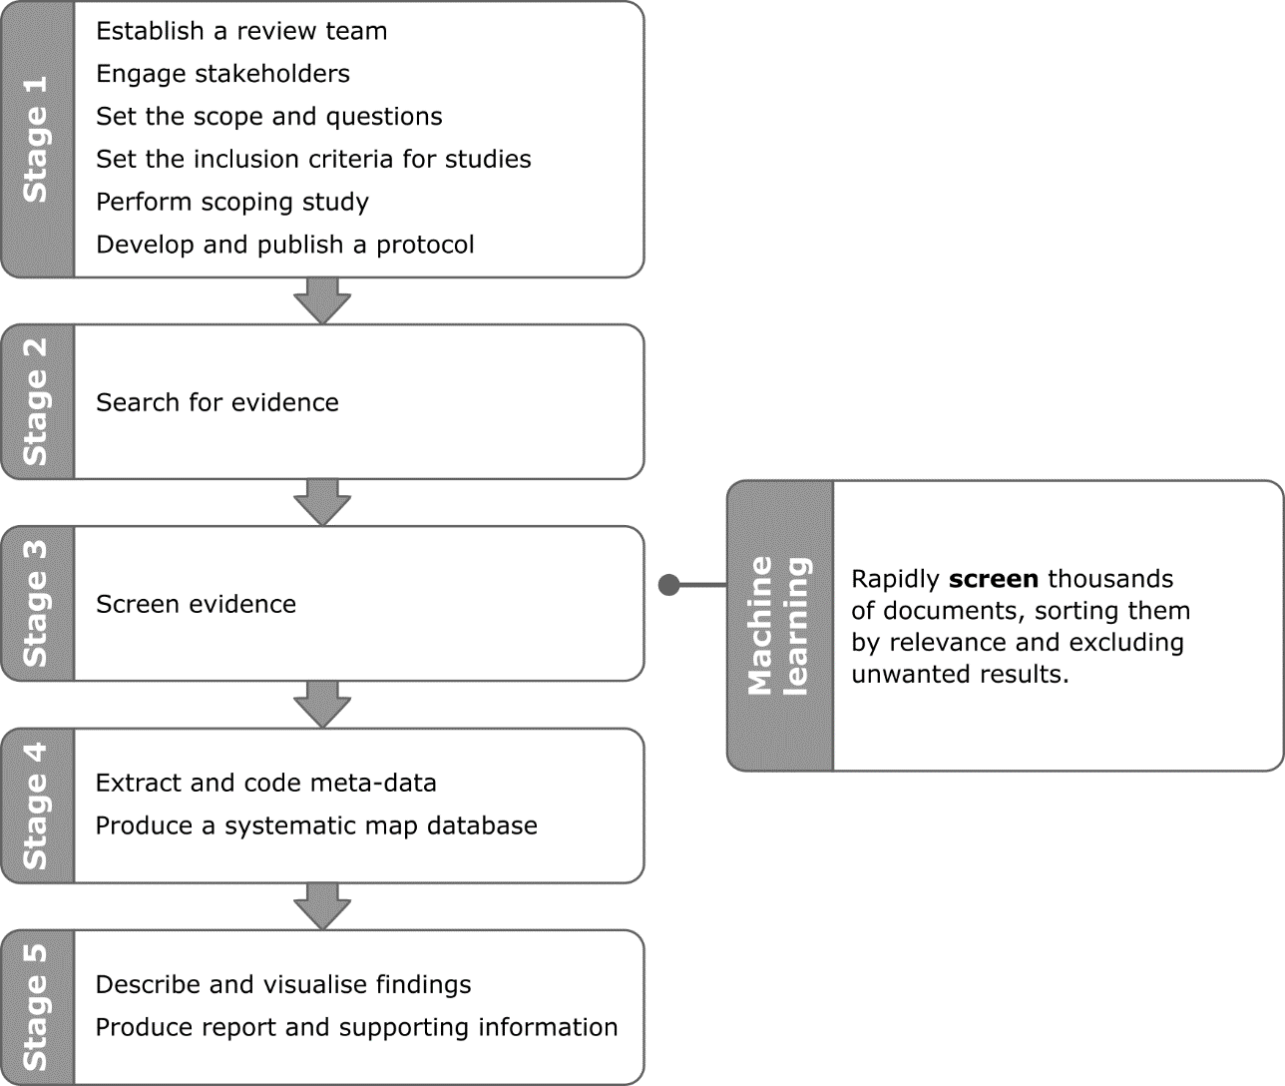
Use machine learning

Slide 10
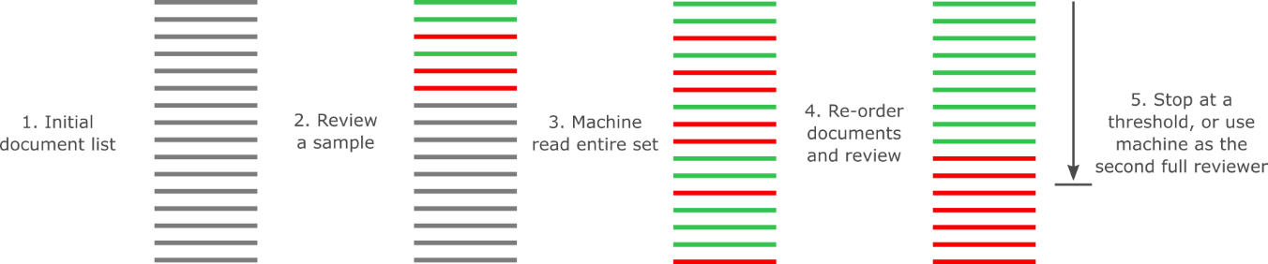
Use machine learning
Available in: Colandr, EPPI-Reviewer, Rayyan, StArt, SWIFT-review, SyRF
See also:
Cheng S H et al. 2018 Using machine learning to advance synthesis and use of conservation and environmental evidence Conserv. Biol. 32 762–4
Roll U, Correia R A and Berger-Tal O 2018 Using machine learning to disentangle homonyms in large text corpora Conserv. Biol. 32 716–24

Slide 11
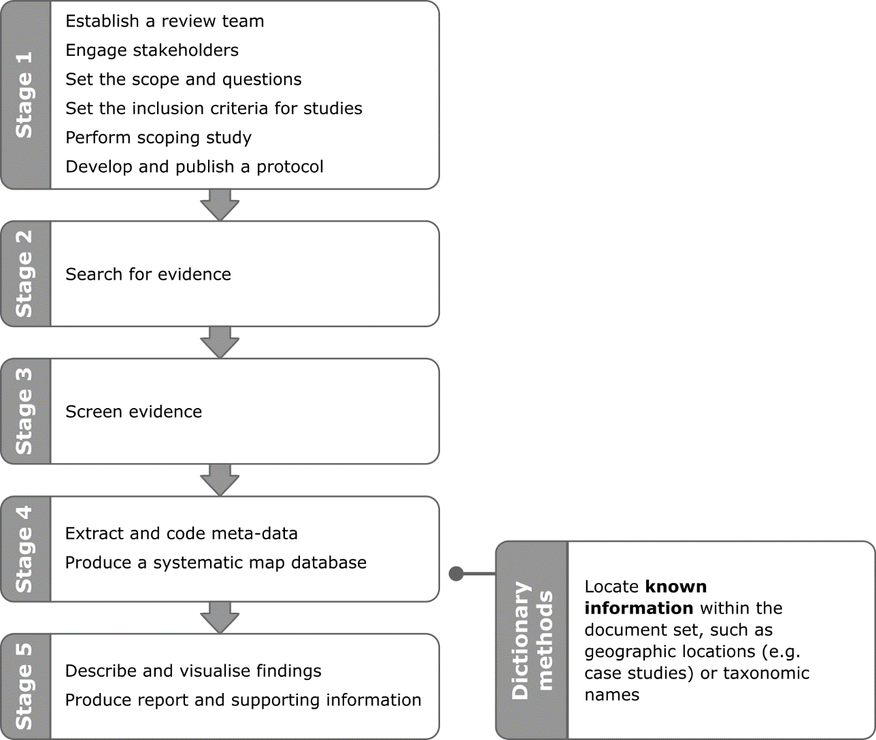
Use dictionary methods

Slide 12
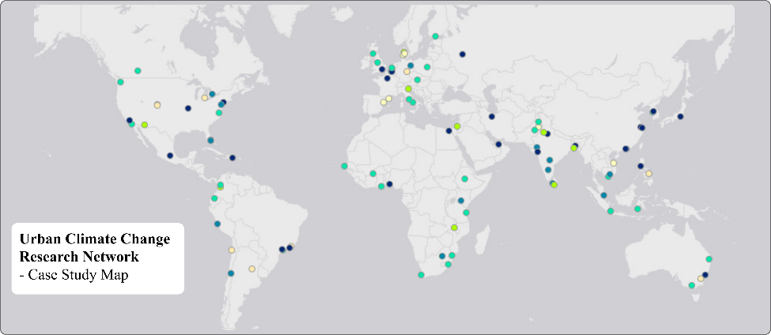
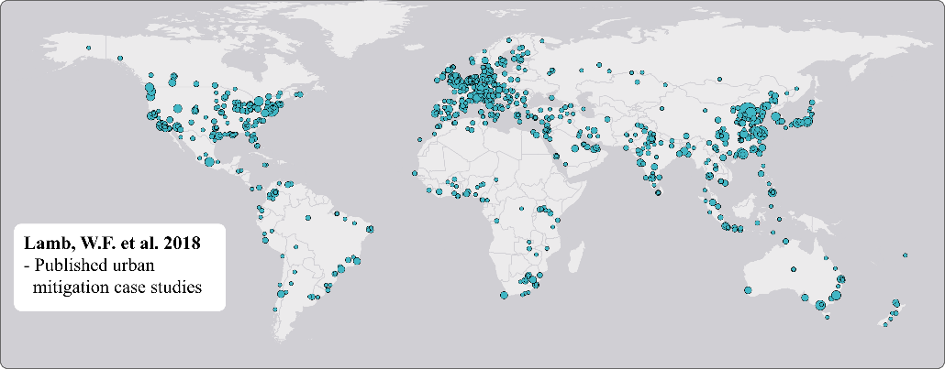
Use dictionary methods
Screen every title and abstract for a list (‘dictionary’) of pre-defined words, e.g.
Country names
City names
Species names (taxa)
Automatically mark up documents accordingly

Slide 13
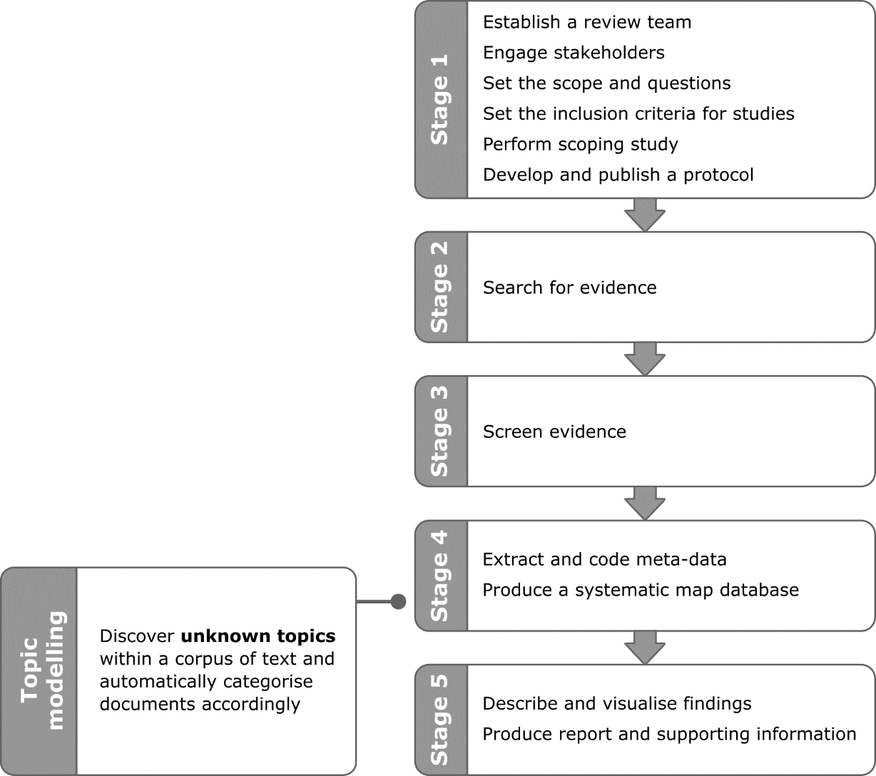
Use topic modelling

Slide 14
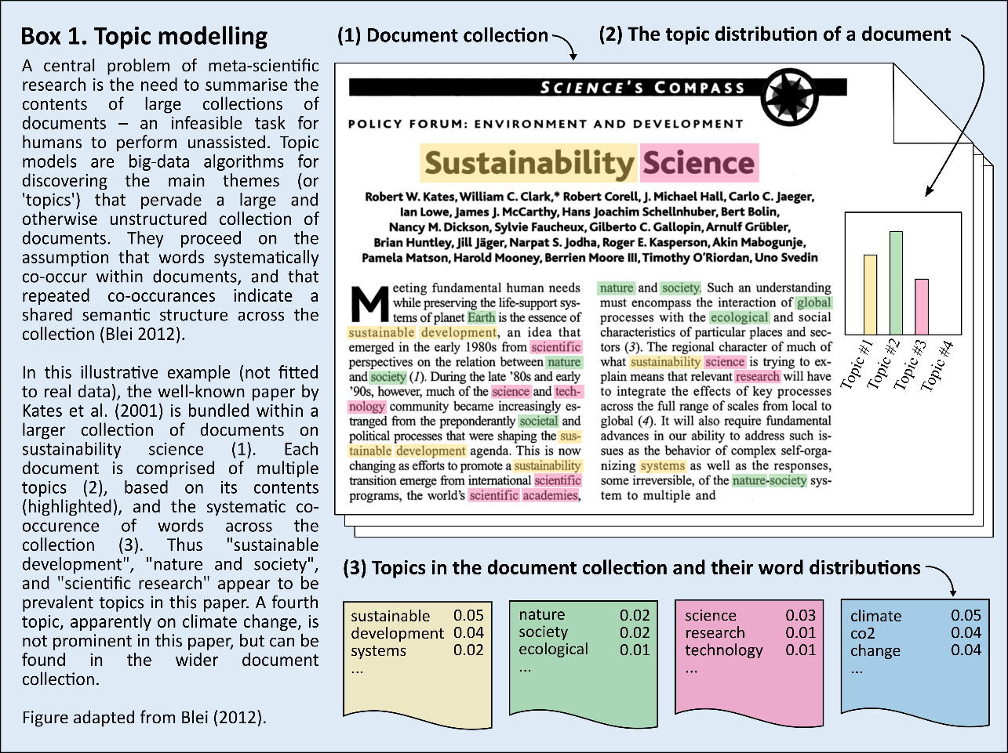
Use topic modelling

Slide 15
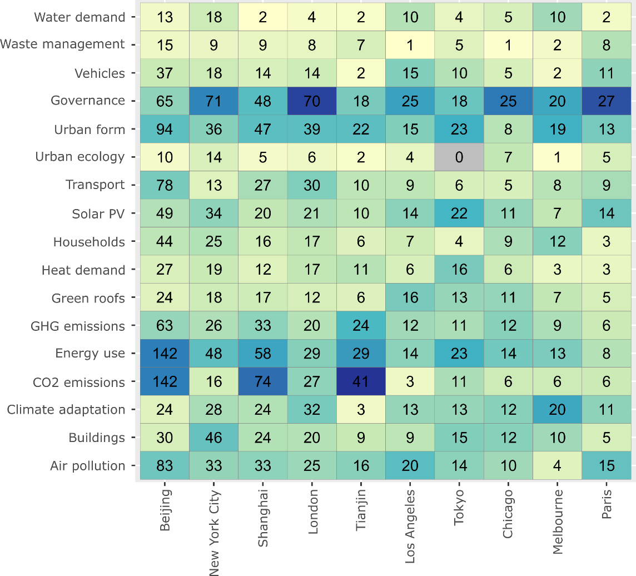
Combine methods – evidence gaps and clusters

Slide 16
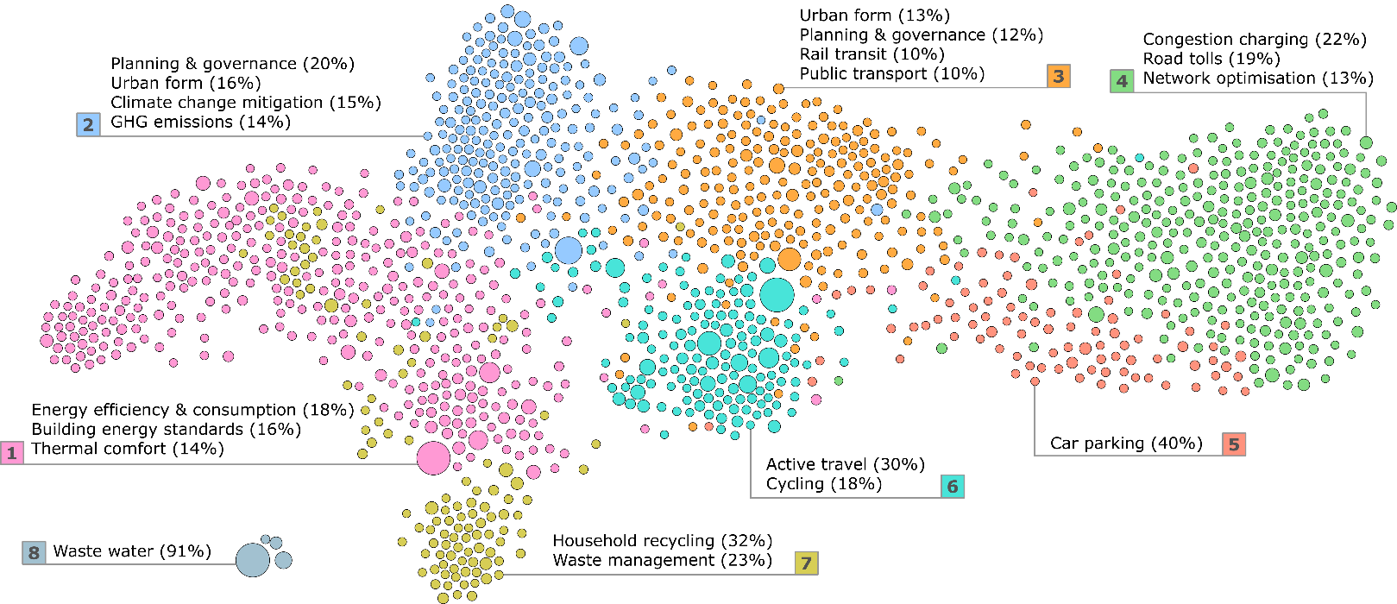
Combine methods – epistemic communities

Slide 17
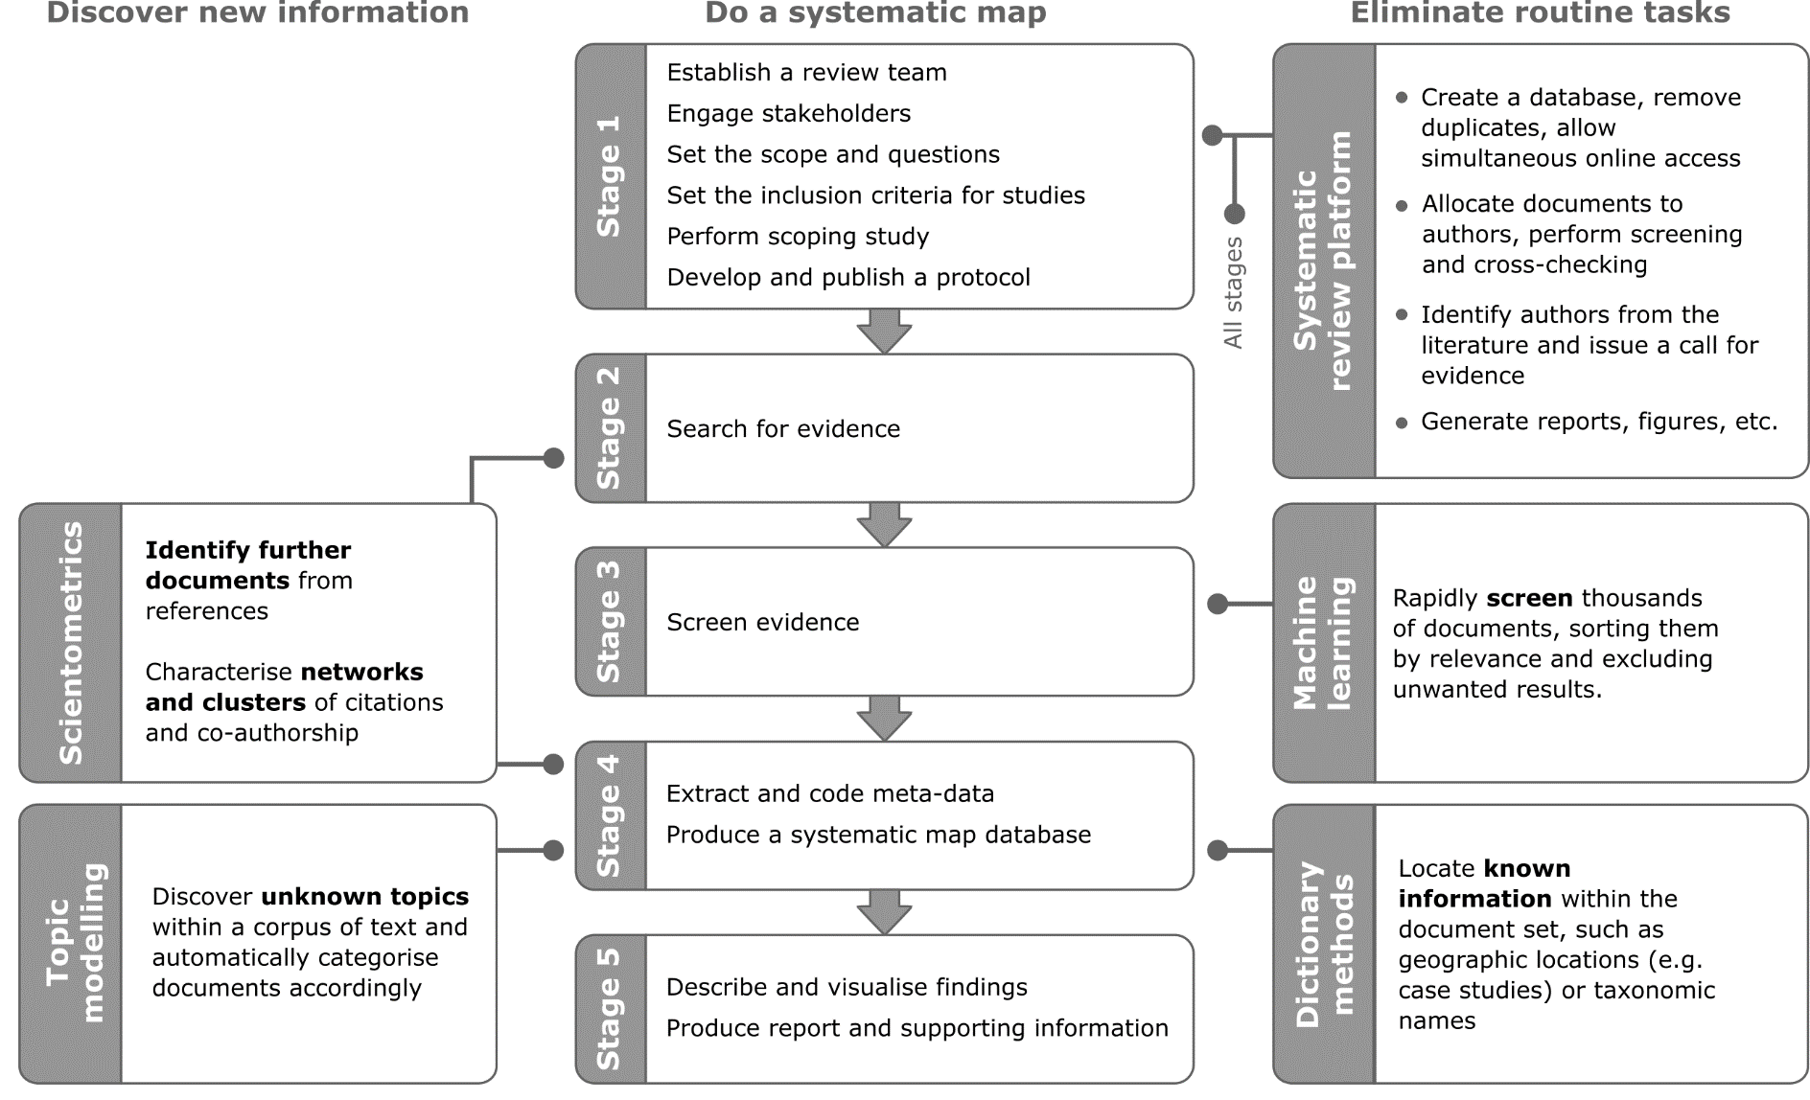

Slide 18
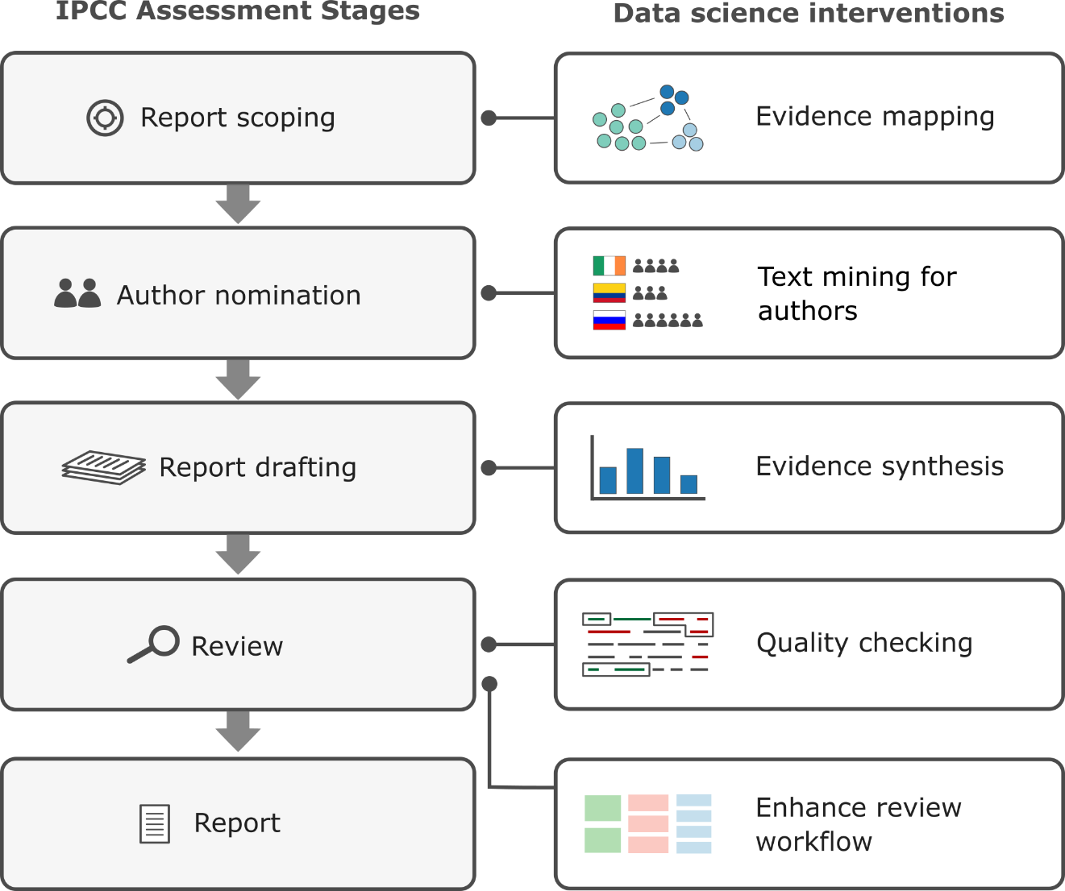
Outlook – IPCC and beyond

